Slide 1

Digitalization of the MCA department
BMS INSTITUTE OF TECHNOLOGY & MANAGEMENT
(An Autonomous institution under VTU, Belagavi) Avalahalli,
Doddaballapura Main Road, Yelahanka, Bangalore-64
Department of MCA
Major Project [22MCA401]
An autonomous Institution under VTU
GROUP MEMBERS:
STUDENT NAME : SHASHANK K USN: 1BY22MC047 DATE OF SUBMISSION: 18/05/2024
INTERNAL GUIDE:
DR SHIVAKUMARA T
ASSISTANT PROFFESER OF MCA DEPT
BMSIT

Slide 2
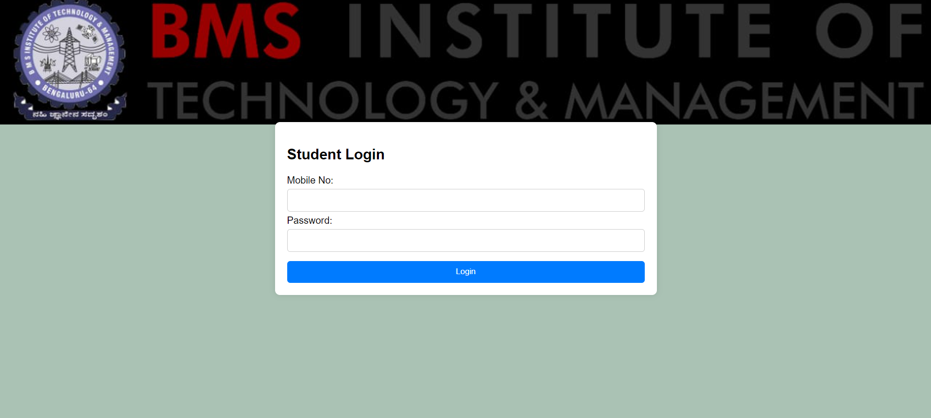
AGENDA
Introduction
Literature survey
Problem statement
objective
Methodology
Conclusion

Slide 3
Introduction
The digitalization of the MCA (Master of Computer Applications) department marks a significant shift towards modernizing administrative and educational processes within the realm of computer science. Embracing digitalization entails leveraging technology to streamline tasks such as student admissions, course registration, academic record management, and communication channels. Through the implementation of digital tools and platforms, the MCA department can enhance efficiency, accessibility, and transparency in its operations. This transition not only facilitates smoother administrative workflows but also enriches the learning experience for students by providing access to online resources, virtual classrooms, and collaborative platforms. Moreover, digitalization opens avenues for data-driven decision-making and analytics, empowering the department to make informed strategic choices and optimize resource allocation. Ultimately, the digitalization of the MCA department paves the way for a more agile, responsive, and future-ready educational ecosystem that aligns with the evolving needs of the digital age.

Slide 4

LITERATURE SURVEY

Slide 5
Literature survey
Sl no | Year | AUTHOR | DESCRIPTION
1 | 2016 | K. Das & S. Bhattacharya | This research explores the benefits of online collaborative learning platforms in fostering teamwork, communication, and problem-solving skills among MCA students.
2 | 2017 | A. Patel | This paper identifies key challenges faced by MCA departments during digital transformation, such as faculty training, infrastructure upgrades, and curriculum development.
3 | 2018 | R. Khan | This research discusses the need to integrate Artificial Intelligence (AI) and Machine Learning (ML) into the MCA curriculum. It explores various courses and projects that can help students develop expertise in these fields

Slide 6
Sl no | year | author | descripition
4 | 2019 | S. Rao & P. Joshi | This paper highlights the growing importance of big data in various industries. It explores how MCA programs can be adapted to equip students with big data analysis skills and tools..
5 | 2020 | A. Gupta | This research explores the potential of cloud computing in MCA education. It discusses how cloud platforms can be used for delivering software development courses, big data analytics, and other practical applications.

Slide 7
Problem statement
The digitalization of the MCA department aims to enhance educational and administrative processes through the integration of advanced digital technologies. This initiative will streamline communication, facilitate online learning, and improve access to resources for students and faculty. By adopting digital tools for course management, data analysis, and virtual collaboration, the department will increase efficiency, support innovative teaching methods, and better prepare students for the demands of the digital age..

Slide 8
objective
• Make academic resources and administrative services easily accessible to students, faculty, and staff through an online platform.
• Enable students to complete various academic tasks, such as course registration, fee payment, and accessing study materials, without the constraints of physical presence or time limitations.
• Facilitate seamless communication between students, faculty, and administrative staff through digital channels, such as email, discussion forums, and messaging systems.
• Ensure the security of online transactions related to fee payments, application submissions, and other financial activities through robust encryption and authentication measures.
• Provide comprehensive information about courses, syllabi, academic calendars, examination schedules, and other relevant details to help students make informed decisions about their academic pursuits.

Slide 9
Methodology

Slide 10
Summary
In the project the total of vehicles on each lane is estimated and state (ON/OFF) of LEDs change accordingly hence program flow is simpler and processing overhead is reduced.
System does congestion detection using IR sensor which reduces complexity.
The projected smart density based traffic light system resolves this problem by utilizing IR sensors.

Slide 11

Thank you

